Slide 1
ETC Programmer Workshop 1
Basic Linear Algebra for Game Programmers
By Terri Lim

Slide 2
Topics Covered Today
Quick Recap of Vectors
Dot Product
Cross Product
Vector Projection
Slides & Unity examples can be found here.
https://github.com/TypeDefinition/ETC-Programmer-Workshops

Slide 3
Focus of Today
How can we apply linear algebra in our games?
How is it useful to us as programmers?
What are some scenarios where we can apply these linear algebra concepts?

Slide 4
A Quick Recap of Vectors
A quantity that has both direction and magnitude (length).
Used to represent many things such as direction, velocity, forces etc.
A vector of length 1 is known as a unit vector.
In games, we generally use 2D and 3D vectors.
V_{2D} = (x, y)
V_{3D} = (x, y, z)

Slide 5
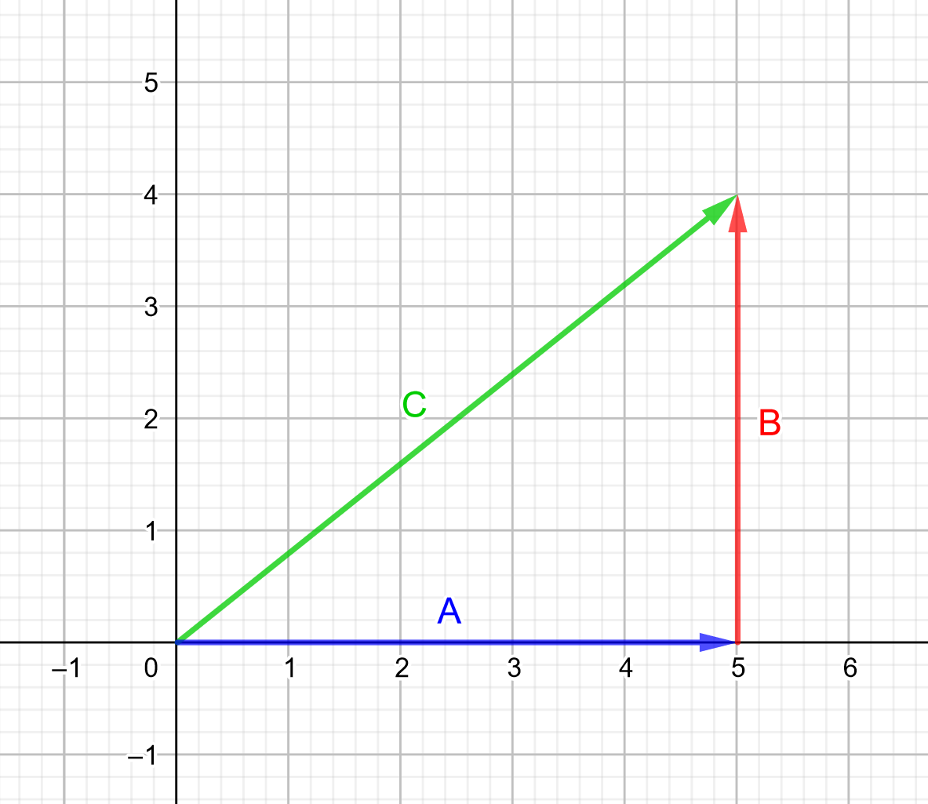
Vector Addition (Tip-to-Tail)
Vectors can be summed using the tip-to-tail method.
Example 1:
A = (5, 0)
B = (0, 4)
C = A + B = (5, 4)
Notes:
https://www.geogebra.org/m/bAnquQpH

Slide 6
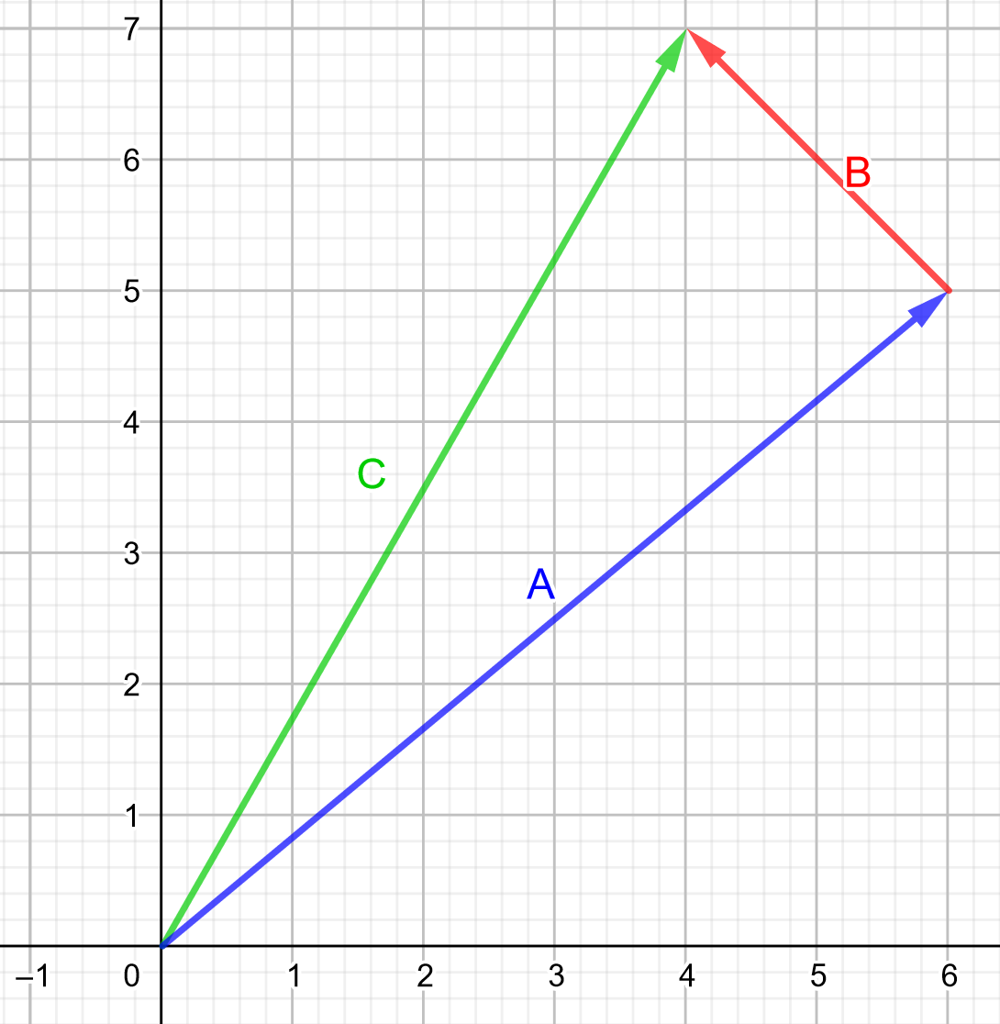
Vector Addition (Tip-to-Tail)
Vectors can be summed using the tip-to-tail method.
Example 2:
A = (6, 5)
B = (-2, 2)
C = A + B = (4, 7)
Notes:
https://www.geogebra.org/m/bAnquQpH

Slide 7
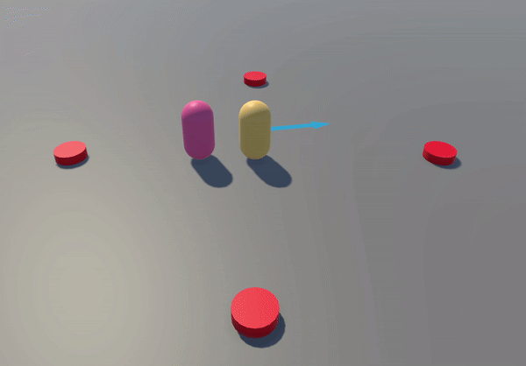
Dot Product - Example 1 (Horror Game)
Horror Game
Player trapped in a room with multiple monster spawners.
We only want to spawn monsters BEHIND the player to maximise the scariness.
Use dot product to check if spawner is behind player.

Slide 8
Dot Product - What is it?
What is the intuition behind it?
Tells us how much 2 vectors point in the same direction.
Formula
Let A = (x_{A}, y_{A}, z_{A}), B = (x_{B}, y_{B}, z_{B})
Then, A⋅B = (X_{A})(X_{B}) + (Y_{A})(Y_{B}) + (Z_{A})(Z_{B})
Useful tips:
If the angle between 2 vectors are less than 90°, the dot product is POSITIVE.
If the angle between 2 vectors are more than 90°, the dot product is NEGATIVE.
If the angle between 2 vectors are exactly 90°, the dot product is ZERO.

Slide 9
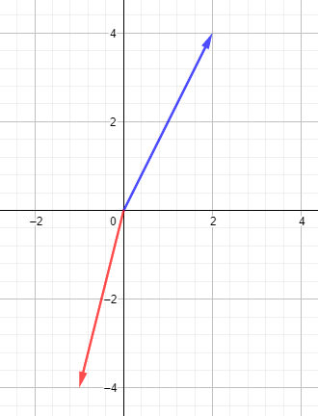
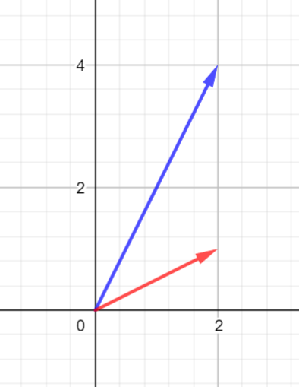
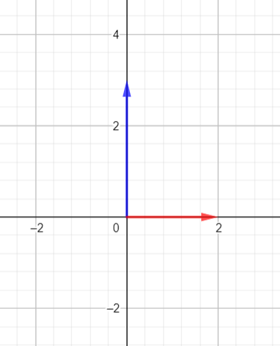
Dot Product - Positivity and Negativity
Angle > 90°:
(2, 4) ⋅ (-1, -4)
= (2)(-1) + (4)(-4)
= -18
∴ (2, 4) ⋅ (-1, -4) < 0
Angle < 90°:
(2, 4) ⋅ (2, 1)
= (2)(2) + (4)(1)
= 8
∴ (2, 4) ⋅ (2, 1) > 0
Angle = 90°:
(0, 3) ⋅ (2, 0)
= (0)(2) + (3)(0)
= 0
∴ (0, 3) ⋅ (2, 0) = 0

Slide 10
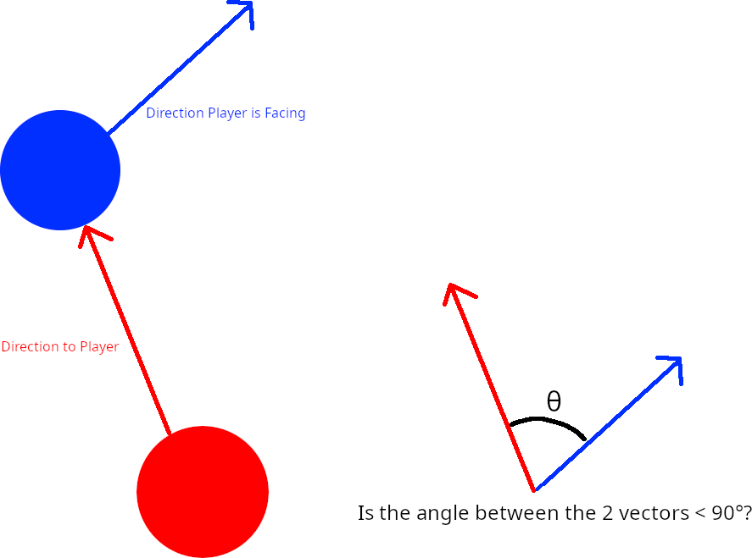
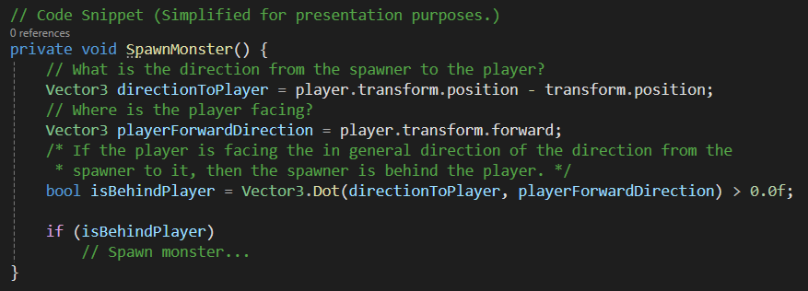
Code Snippet

Slide 11
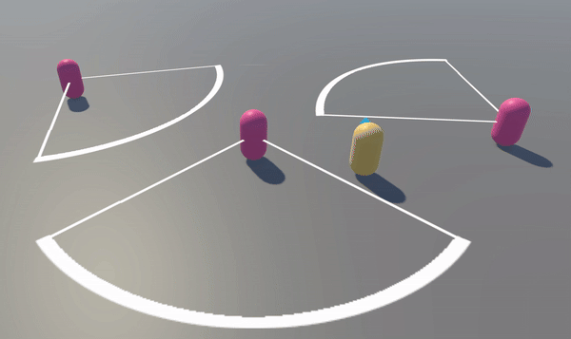
Dot Product - Example 2 (Stealth Game)
Stealth Game
Player is sneaking past enemy.
Enemy’s field of view is 90°.
Enemy detects player if player is within the enemy’s field of view.
Use dot product to check if the player is inside the enemy’s field of view.

Slide 12
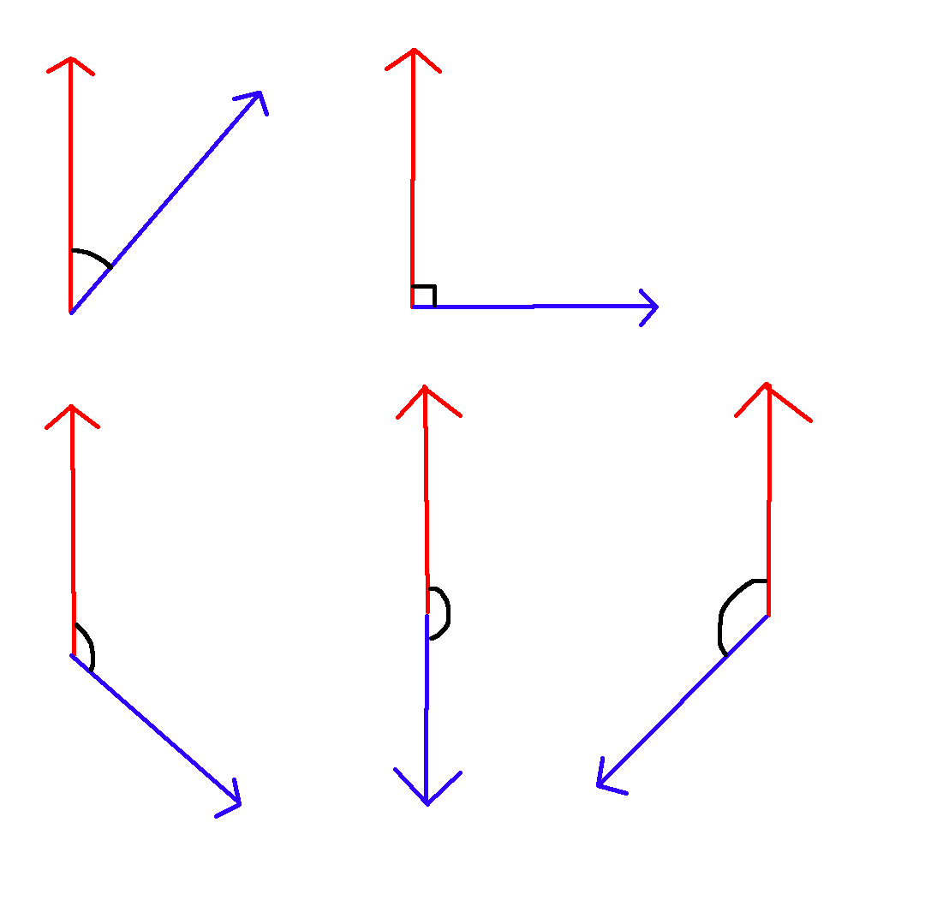
Dot Product - Angle Between 2 Vectors
Recall the formula to find the smallest angle between 2 vectors.
A⋅B = |A||B|cosθ
cosθ = (A⋅B) / (|A||B|)
θ = acos[(A⋅B) / (|A||B|)], where 0 ≤ θ ≤ π
The above formula is further simplified if A and B are unit vectors.
If A and B are unit vectors, |A||B| = 1, then θ = acos(A⋅B).
This formula only gives you the smallest angle between 2 vectors!
θ is never negative!
θ doesn’t give you the < 0 and > π range!

Slide 13
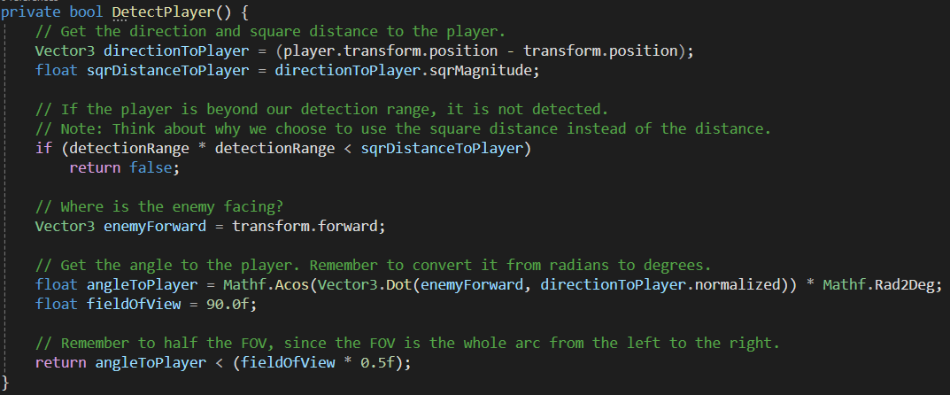
Code Snippet

Slide 14
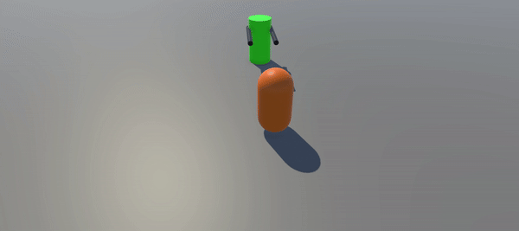
Example 3 - Tower Defence (Mini Exercise)
Tower Defence
You are in-charge of programming the turret in a tower defense game.
You need to rotate the turret to face the enemy.
You already know how to calculate how many degrees to rotate your turret.
But how do you know to rotate clockwise or anti-clockwise?

Slide 15
Example 3 - Tower Defence (Mini Exercise)
Take a minute to think about it!
Try to recall your undergrad linear algebra!
Hint:
It’s written in the contents section of this presentation. 😛
All examples here will be uploaded to GitHub for future reference.
https://github.com/TypeDefinition/ETC-Programmer-Workshops

Slide 16
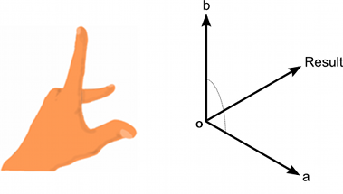
Cross Product - What is it?
What is the intuition behind it?
Takes in 2 vectors and spits out a vector orthogonal to the input vectors.
Length of resultant vector is equivalent to area of parallelogram form by the 2 input vectors.
A×B = -(B×A)
Cross product is anticommutative! Order of operands matter!
Formula
Let A = (x_{A}, y_{A}, z_{A}), B = (x_{B}, y_{B}, z_{B})
A×B = (y_{A}z_{B} - z_{A}y_{B}, z_{A}x_{B} - x_{A}z_{B}, x_{A}y_{B} - y_{A}x_{B})
Notes:
Unity uses a left-hand coordinate system.
Stretch your fingers as shown in the diagram on the right.
Cross product of your thumb and index finger is your middle finger.
Cross product of your index finger and your thumb is the opposite of your middle finger.

Slide 17
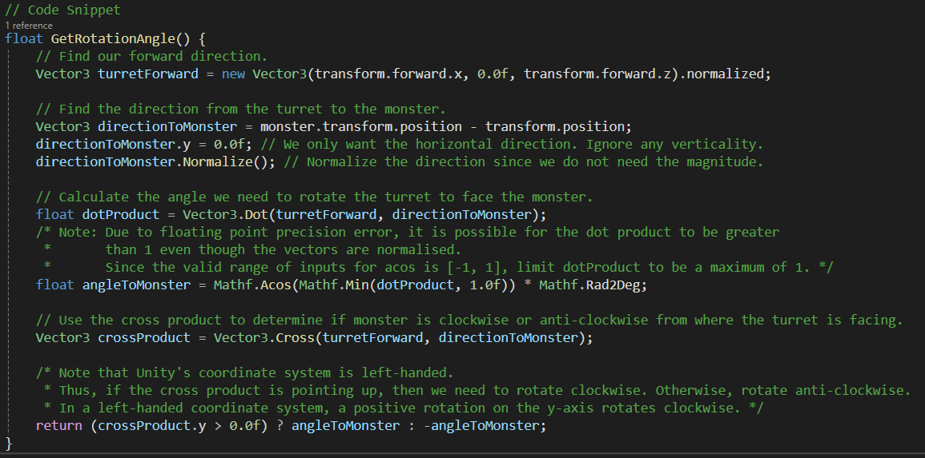
Code Snippet

Slide 18
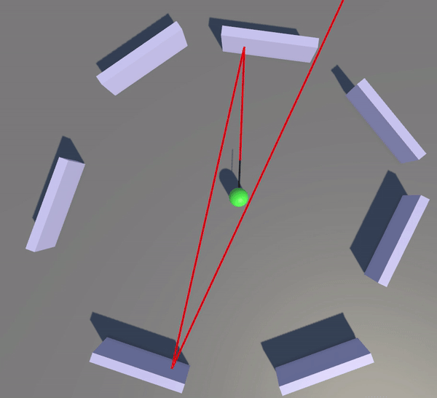
Vector Projection - Example 4 (Laser)
Laser
You are making a platformer game.
One of the obstacles in the game is a laser which bounces off the walls.
Use vector projection to calculate the laser bounce direction.

Slide 19
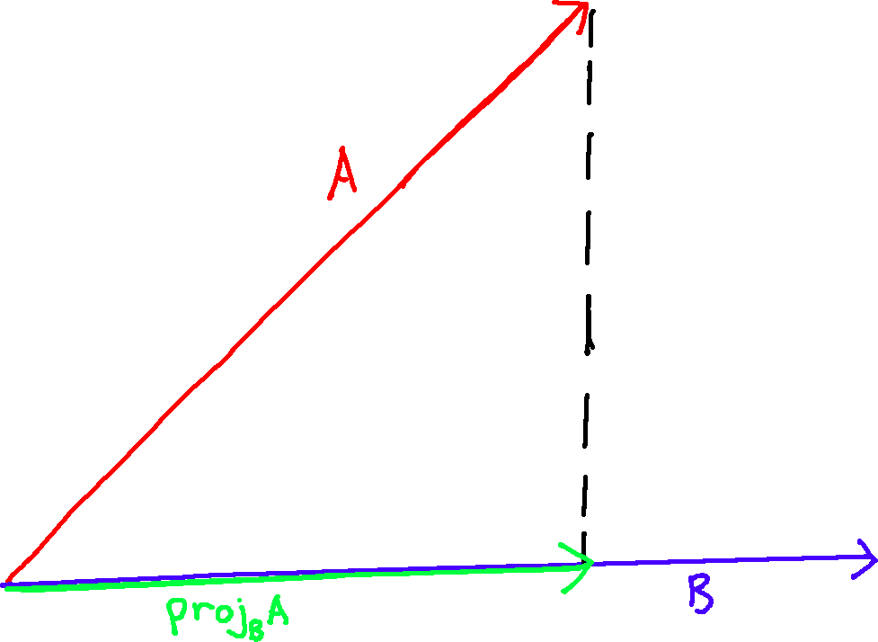
Vector Projection - What is it?
What is the intuition behind it?
Projecting A onto B, or proj_{B}A, gives us the component of A that is in the same direction as B.
Formula
proj_{B}A = [(A⋅B)/(B⋅B)] * B
Notes:
Notice that the vector projection formula normalises B.
Therefore the projection is not affected by the magnitude of B, for |B| > 0.

Slide 20
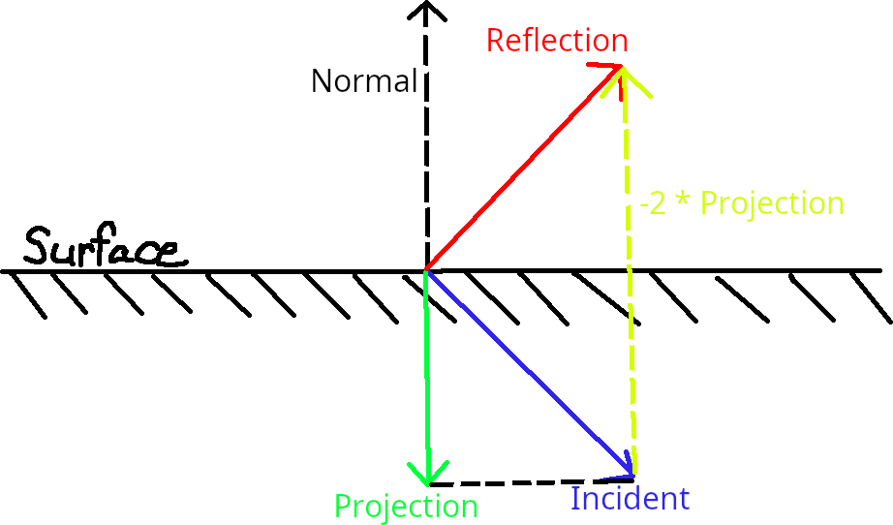
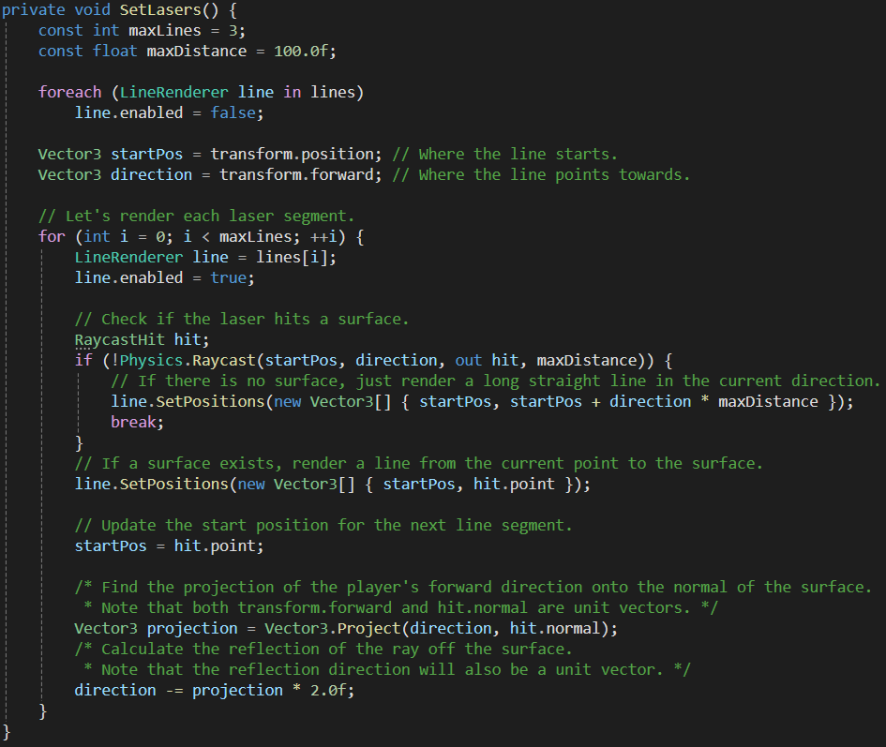
Code Snippet

Slide 21
The End

Slide 22
Q&A

